Slide 1
Synergetic Empatico
Deepak
Prajwal
Mamtha
Muruganantham
Poornima

Slide 2

Why “Synergetic Empatico”?
Visits through Social Media
Admission process
01
04
02
03
Got Placed
Technical Learning
Notes:
Notes to presenter:
What did you think at first?
What obstacles did you encounter along the way?
How did you overcome those obstacles?
What images can you add to support your process?
This SmartArt allows you add images and text to help outline your process. If a picture is worth a thousand words, then pictures and words should help you communicate this reflection on learning perfectly! You can always click on Insert>SmartArt to change this graphic or select the graphic and click on the Design contextual menu to change the colors.
Feel free to use more than one slide to reflect upon your process. It also helps to add some video of your process.

Slide 3

Purpose of the Workshop
Notes:
Notes to presenter:
What is your purpose for sharing this reflection?
Is it at the end of a unit or project?
Are you sharing this reflection, at the attainment of a learning goal you set for yourself?
Is it at the end of a course?
State your purpose for the reflection or even the purpose of the learning experience or learning goal. Be clear and be specific in stating your purpose.

Slide 4


What did we learn in this Workshop?
Puting custormers First. Core value of the Organization.
Notes:
Notes to presenter:
Description of what you learned in your own words on one side.
Include information about the topic
Details about the topic will also be helpful here.
Tell the story of your learning experience. Just like a story there should always be a beginning, middle and an end.
On the other side, you can add a graphic that provides evidence of what you learned.
Feel free to use more than one slide to reflect upon your process. It also helps to add some video of your process.

Slide 5
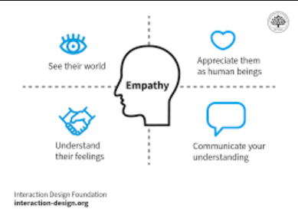
What did we learn in this Workshop?
Puting custormers First. Core value of the Organization.
Importance of Empathy
Mentor with Empathy
Mentor without Empathy
Notes:
Notes to presenter:
Description of what you learned in your own words on one side.
Include information about the topic
Details about the topic will also be helpful here.
Tell the story of your learning experience. Just like a story there should always be a beginning, middle and an end.
On the other side, you can add a graphic that provides evidence of what you learned.
Feel free to use more than one slide to reflect upon your process. It also helps to add some video of your process.

Slide 6
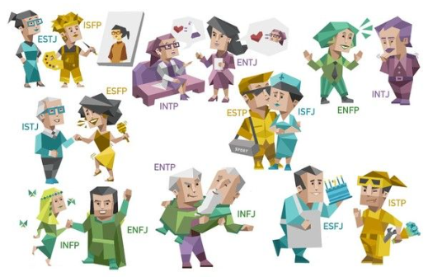
What did we learn in this Workshop?
Puting custormers First. Core value of the Organization.
Importance of Empathy
Mentor with Empathy
Mentor without Empathy
Learnt about MBTI – “It is What it is”
Ready to get Influence - Basically we have to influence customers towards the goal(Getting Placed)
Notes:
Notes to presenter:
Description of what you learned in your own words on one side.
Include information about the topic
Details about the topic will also be helpful here.
Tell the story of your learning experience. Just like a story there should always be a beginning, middle and an end.
On the other side, you can add a graphic that provides evidence of what you learned.
Feel free to use more than one slide to reflect upon your process. It also helps to add some video of your process.

Slide 7

How will MBTI knowledge help me and Team Emertxe?
Understand overselves and improve ourselves
Notes:
Notes to presenter:
Description of what you learned in your own words on one side.
Include information about the topic
Details about the topic will also be helpful here.
Tell the story of your learning experience. Just like a story there should always be a beginning, middle and an end.
On the other side, you can add a graphic that provides evidence of what you learned.
Feel free to use more than one slide to reflect upon your process. It also helps to add some video of your process.

Slide 8

How will MBTI knowledge help me and Team Emertxe?
Understand overselves and improve ourselves
Helps interaction in the working environment
Notes:
Notes to presenter:
Description of what you learned in your own words on one side.
Include information about the topic
Details about the topic will also be helpful here.
Tell the story of your learning experience. Just like a story there should always be a beginning, middle and an end.
On the other side, you can add a graphic that provides evidence of what you learned.
Feel free to use more than one slide to reflect upon your process. It also helps to add some video of your process.

Slide 9

How will MBTI knowledge help me and Team Emertxe?
Understand overselves and improve ourselves
Helps interaction in the working environment
Helps interaction with customers
Notes:
Notes to presenter:
Description of what you learned in your own words on one side.
Include information about the topic
Details about the topic will also be helpful here.
Tell the story of your learning experience. Just like a story there should always be a beginning, middle and an end.
On the other side, you can add a graphic that provides evidence of what you learned.
Feel free to use more than one slide to reflect upon your process. It also helps to add some video of your process.

Slide 10

How will MBTI knowledge help me and Team Emertxe?
Understand overselves and improve ourselves
Helps interaction in the working environment
Helps interaction with customers
Increases customer satisfaction
Notes:
Notes to presenter:
Description of what you learned in your own words on one side.
Include information about the topic
Details about the topic will also be helpful here.
Tell the story of your learning experience. Just like a story there should always be a beginning, middle and an end.
On the other side, you can add a graphic that provides evidence of what you learned.
Feel free to use more than one slide to reflect upon your process. It also helps to add some video of your process.

Slide 11

How will MBTI knowledge help us while dealing with our customers?
Understanding Customer’s Personality
Notes:
Notes to presenter:
Description of what you learned in your own words on one side.
Include information about the topic
Details about the topic will also be helpful here.
Tell the story of your learning experience. Just like a story there should always be a beginning, middle and an end.
On the other side, you can add a graphic that provides evidence of what you learned.
Feel free to use more than one slide to reflect upon your process. It also helps to add some video of your process.

Slide 12

How will MBTI knowledge help us while dealing with our customers?
Understanding Customer’s Personality
Connecting emotionally and alligning them with the process
Notes:
Notes to presenter:
Description of what you learned in your own words on one side.
Include information about the topic
Details about the topic will also be helpful here.
Tell the story of your learning experience. Just like a story there should always be a beginning, middle and an end.
On the other side, you can add a graphic that provides evidence of what you learned.
Feel free to use more than one slide to reflect upon your process. It also helps to add some video of your process.

Slide 13

How will MBTI knowledge help us while dealing with our customers?
Understanding Customer’s Personality
Connecting emotionally and alligning them with the process
Making them feel comfortable to reach us
Notes:
Notes to presenter:
Description of what you learned in your own words on one side.
Include information about the topic
Details about the topic will also be helpful here.
Tell the story of your learning experience. Just like a story there should always be a beginning, middle and an end.
On the other side, you can add a graphic that provides evidence of what you learned.
Feel free to use more than one slide to reflect upon your process. It also helps to add some video of your process.

Slide 14

Importance
Relevance
Significance
Empathy
Better connectivity
Word of Mouth / Better Outcome
Notes:
Notes to presenter:
What was important about this learning experience?
How is it relevant to your course, yourself, or your society or community?
Why is this significant?
This SmartArt allows you add images and text to help outline your process. If a picture is worth a thousand words, then pictures and words should help you communicate this reflection on learning perfectly! You can always click on Insert>SmartArt to change this graphic or select the graphic and click on the Design contextual menu to change the colors.

Slide 15
Importance
Relevance
Significance
Empathy
Understand overselves and others
Better connectivity
Adaptability
Word of Mouth / Better Outcome
Better Productivity
Notes:
Notes to presenter:
What was important about this learning experience?
How is it relevant to your course, yourself, or your society or community?
Why is this significant?
This SmartArt allows you add images and text to help outline your process. If a picture is worth a thousand words, then pictures and words should help you communicate this reflection on learning perfectly! You can always click on Insert>SmartArt to change this graphic or select the graphic and click on the Design contextual menu to change the colors.

Slide 16
Importance
Relevance
Significance
Empathy
Understand overselves and others
Customer’s Satisfaction
Better connectivity
Adaptability
Sustainable growth
Word of Mouth / Better Outcome
Better Productivity
Higher Revenue
Competitive Advantage
Notes:
Notes to presenter:
What was important about this learning experience?
How is it relevant to your course, yourself, or your society or community?
Why is this significant?
This SmartArt allows you add images and text to help outline your process. If a picture is worth a thousand words, then pictures and words should help you communicate this reflection on learning perfectly! You can always click on Insert>SmartArt to change this graphic or select the graphic and click on the Design contextual menu to change the colors.

Slide 17
Thank You
Notes:
Notes to presenter:
What is your purpose for sharing this reflection?
Is it at the end of a unit or project?
Are you sharing this reflection, at the attainment of a learning goal you set for yourself?
Is it at the end of a course?
State your purpose for the reflection or even the purpose of the learning experience or learning goal. Be clear and be specific in stating your purpose.

